Slide 1

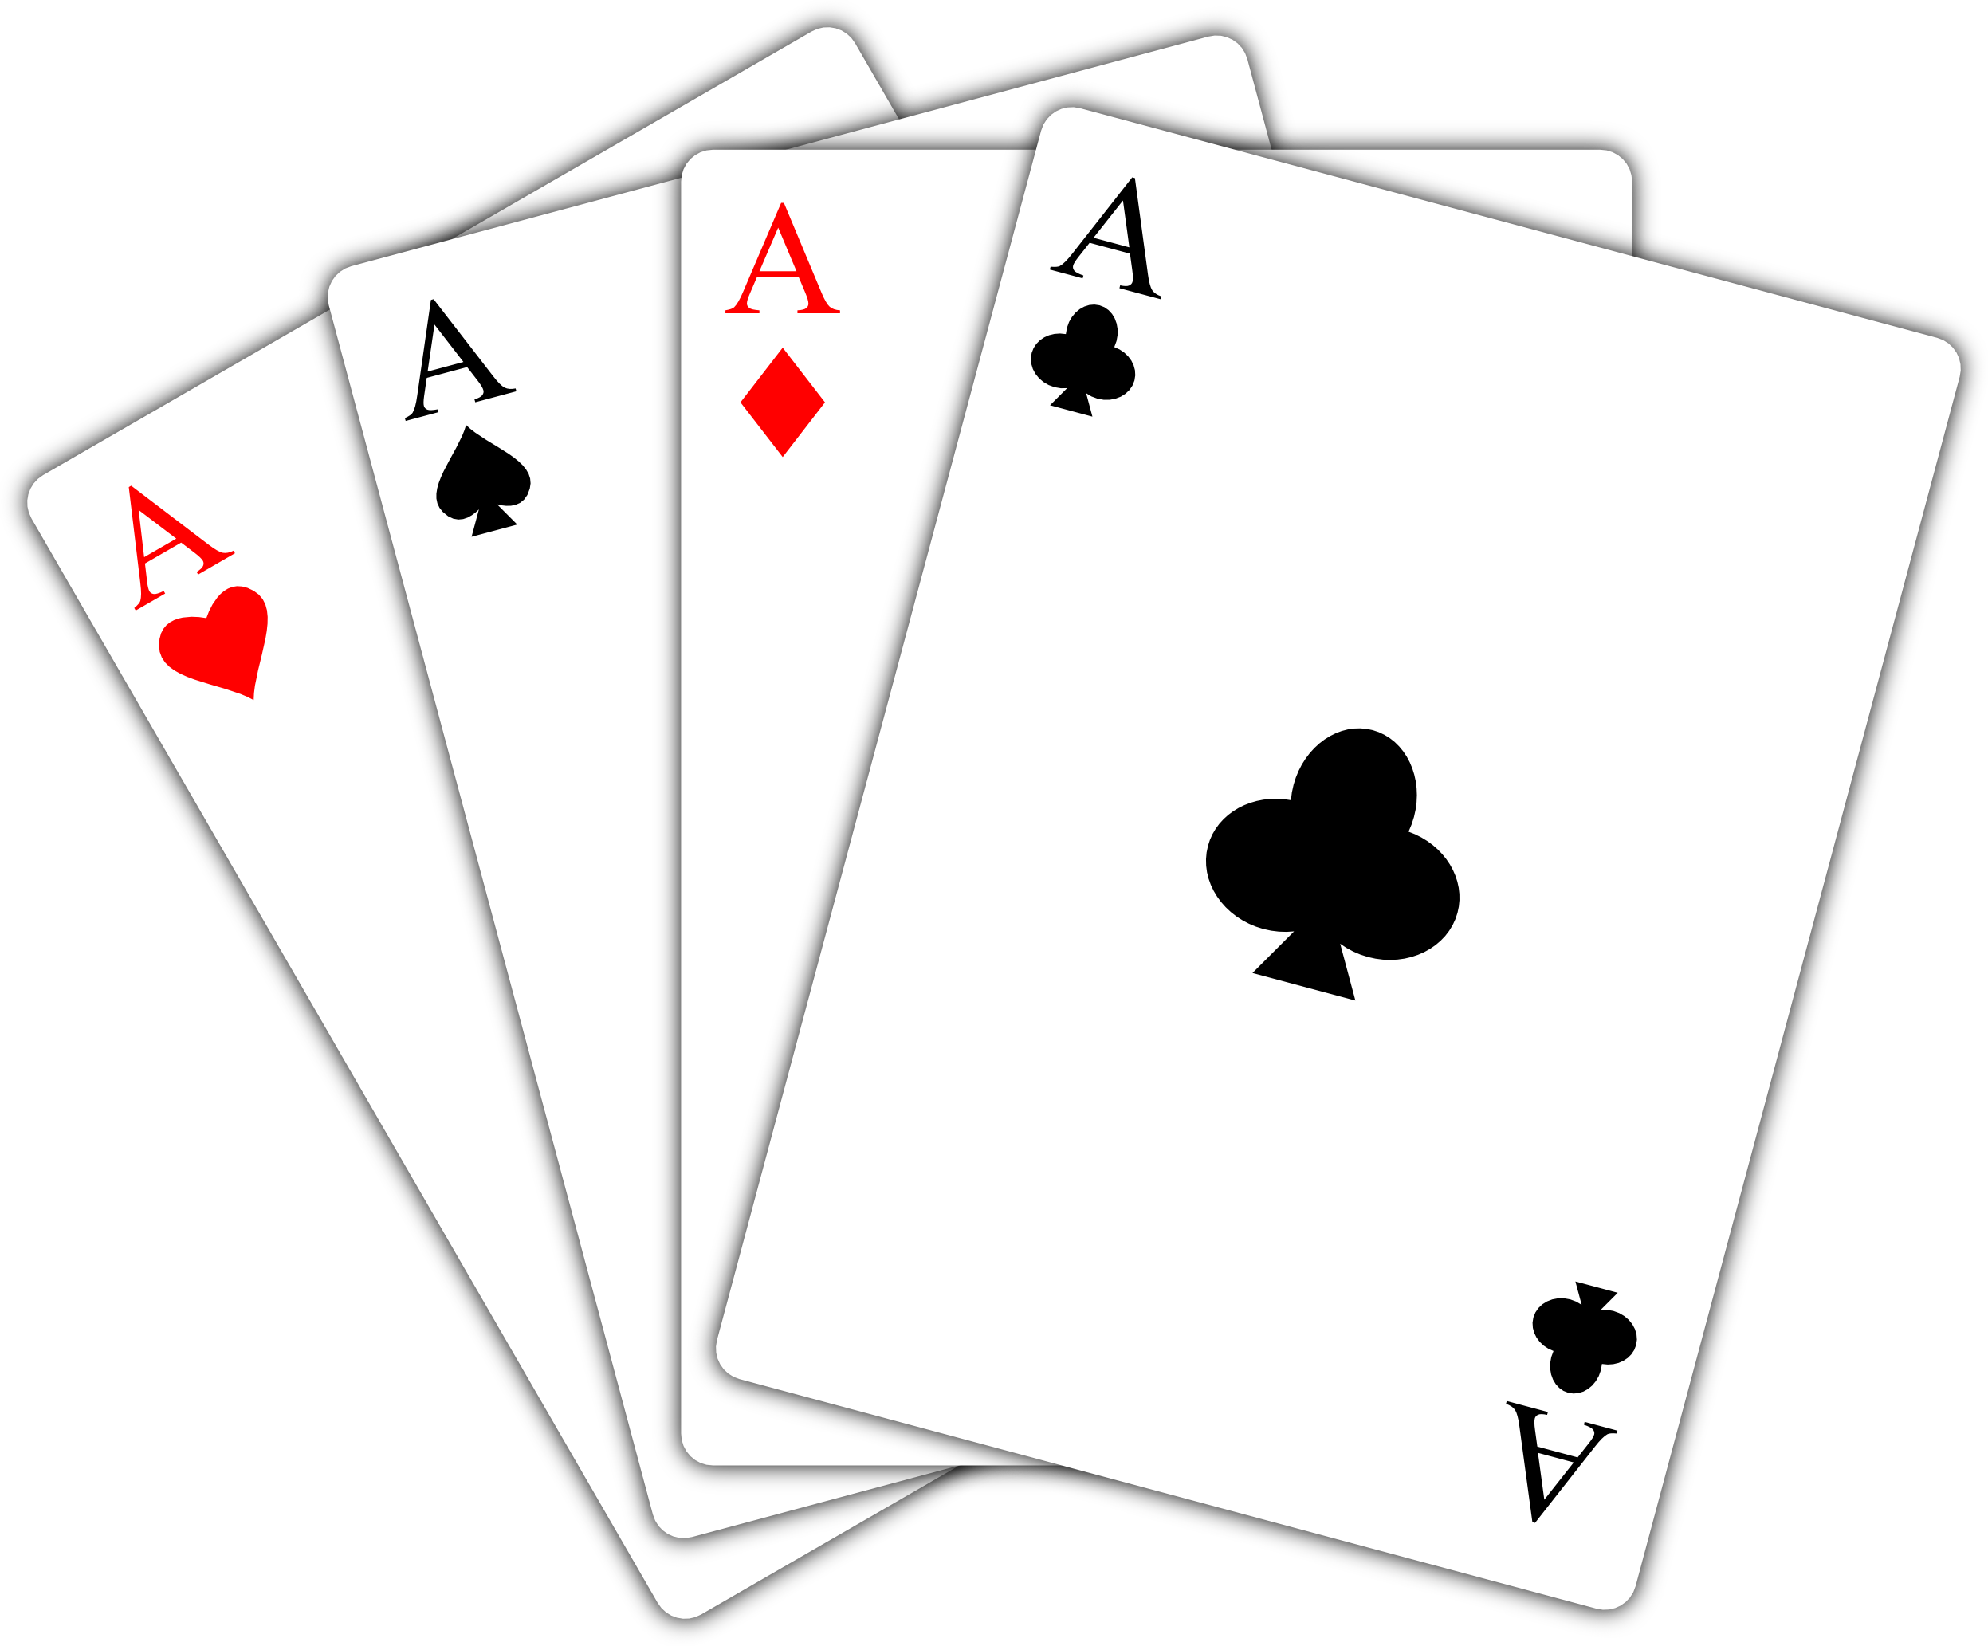
Casino Blackjack
Play the simple, but thrilling card game by trying to get as close to 21 as possible, without going over 21. Can you beat the dealer?
https://github.com/ksu-is/Casino-Blackjack
By Andrew Hessefort & Maggie Cochran

